Slide 1
Linear modelling theory
With multiple explanatory variables

Slide 2
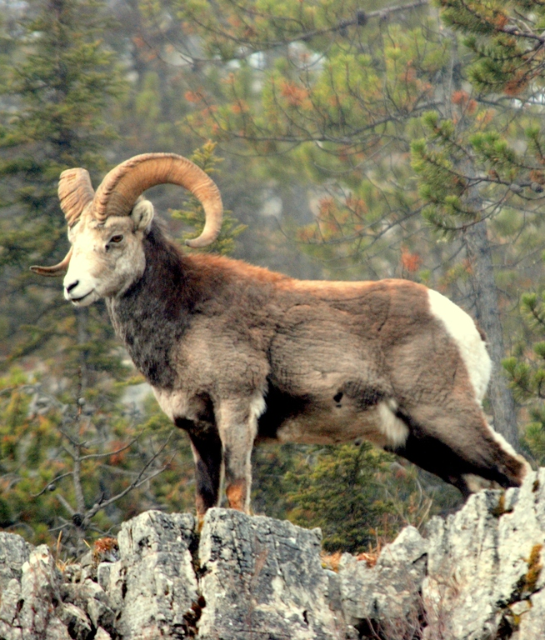
Complexity of the real world
Horn length
Region
Cohort
Last week we wanted to understand the effect of understand hunting pressure on sheep
But we also had cohort
Are these really the only variables impacting horn length?

Slide 3
Complexity of the real world
Mother’s condition
Food availability
Genetics
Horn length
Region
Cohort
Predation
Competition
Age at death

Slide 4
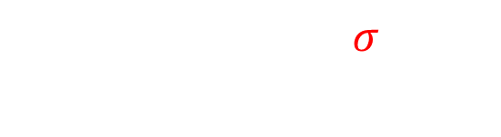
Complexity of the real world
Mother’s condition
Food availability
Genetics
Horn length
Region
Cohort
Predation
Competition
Age at death
$$y_{i}∼Normal\left(μ_{i}, σ\right) \\ μ_{i}=β_{0}+β_{1}×Skeena_{i}$$

Slide 5

How do we capture the Data Generating Process?
So far we’ve covered how to add single variables to a model
But all other influences are still happening
If we don’t include these, they get lumped into $σ$ (i.e. unexplained variation)
How do we include more variables so that we can understand all these different influences?
Mother’s condition
Food availability
Genetics
Horn length
Region
Cohort
Predation
Competition
Age at death

Slide 6
The question

Slide 7
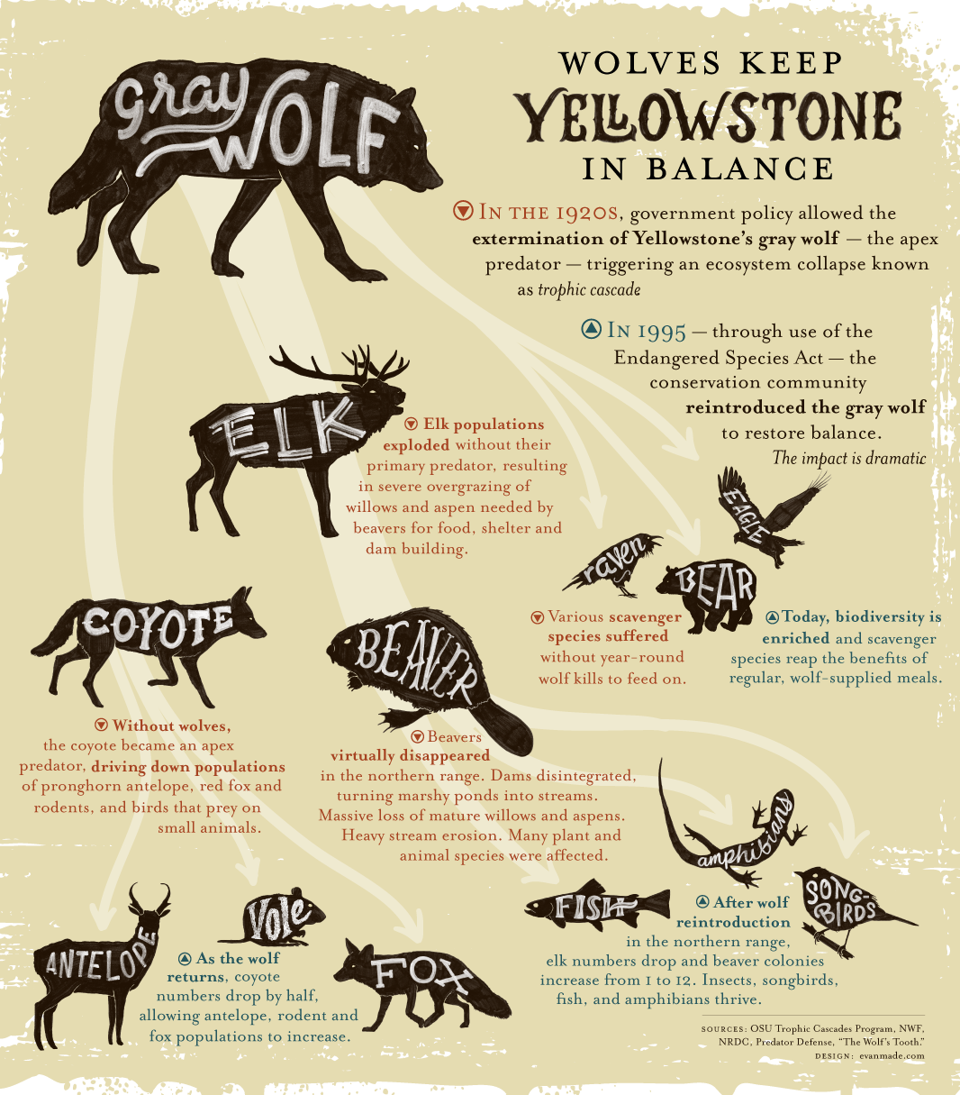
Trophic cascades
Hugely popular ecology theory, especially amongst public
“Nature is healing”
“Keystone species”
Seminal paper described the process

Slide 8
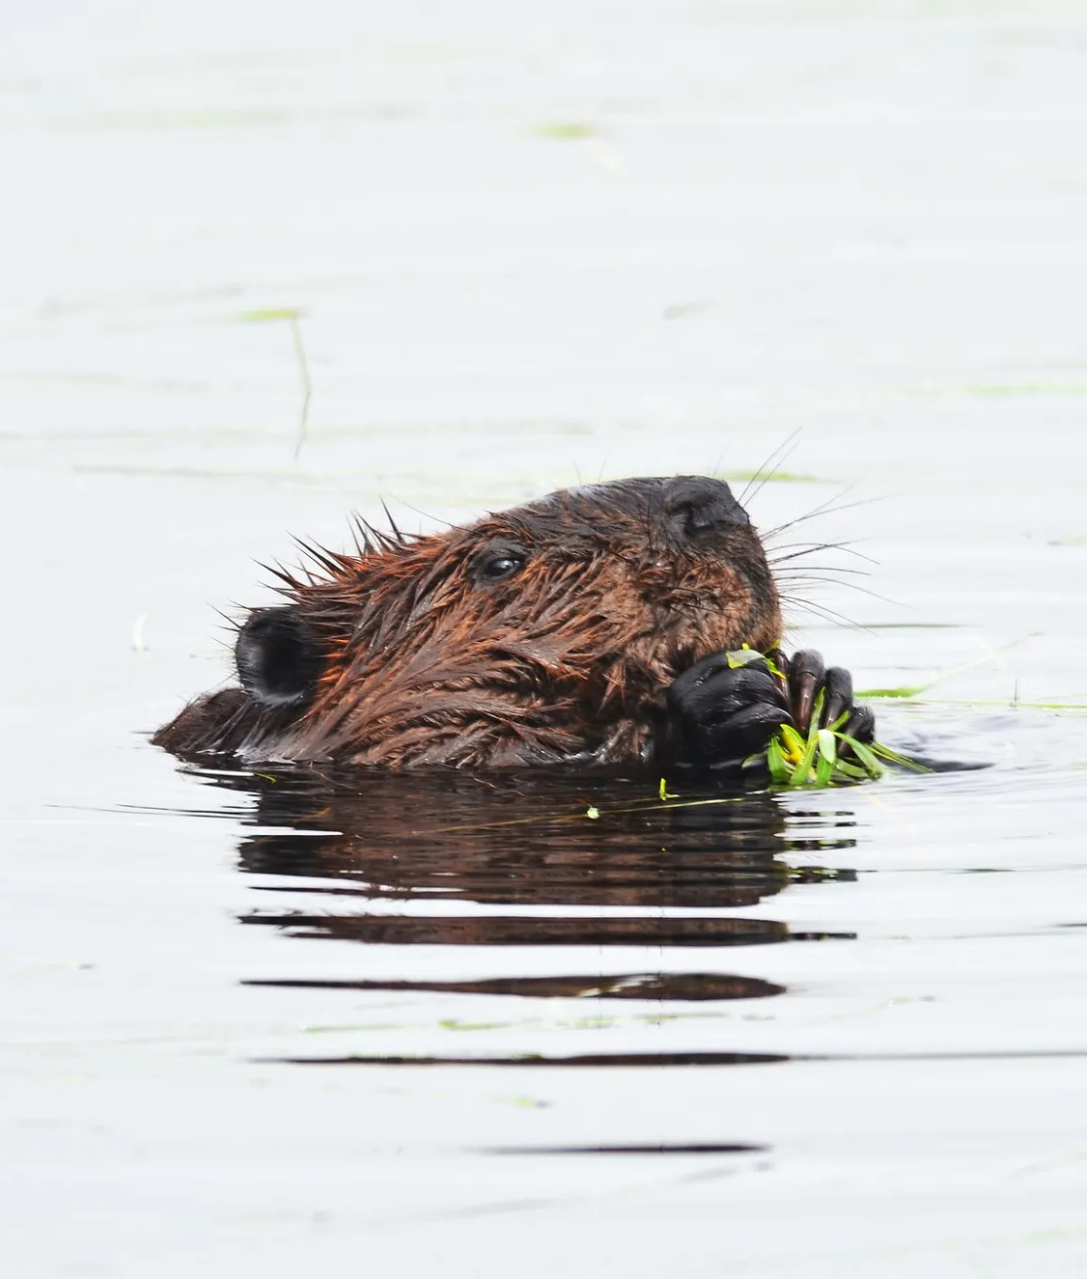



The question
We want to see if wolf presence has a positive relationship with beaver density.
How would you use the tools you have learnt to find evidence of a trophic cascade?
$$B_{i}∼Normal\left(μ_{i}, σ\right) \\ μ_{i}=β_{0}+β_{1}×P_{i}$$
Wolf $P$resence
$B$eaver density

Slide 9
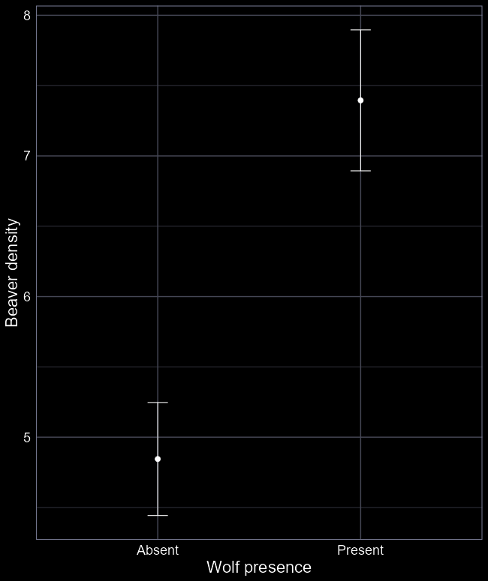
Test hypothesis with lm()
Wolf presence is categorical
You’re all now comfortable fitting these types of models, so we’ll skip to the results
Do wolves increase beaver density?
Is the system really that simple?
Singular causes and effects are incredibly rare in the real world.

Slide 10

Complex worlds
Misinformation often created by attributing singular causes to complex phenomena
Most clickbait
Political sound bites / populism
Health products
Advertising
Fair bit of scientific communication

Slide 11
Incorporate complexity
Wolves won’t be the only thing influencing beaver density
Surely the probability survival to survive from one year to the next will influence beaver density?
How do we include survival?
Wolf presence
Beaver density
Beaver survival

Slide 12
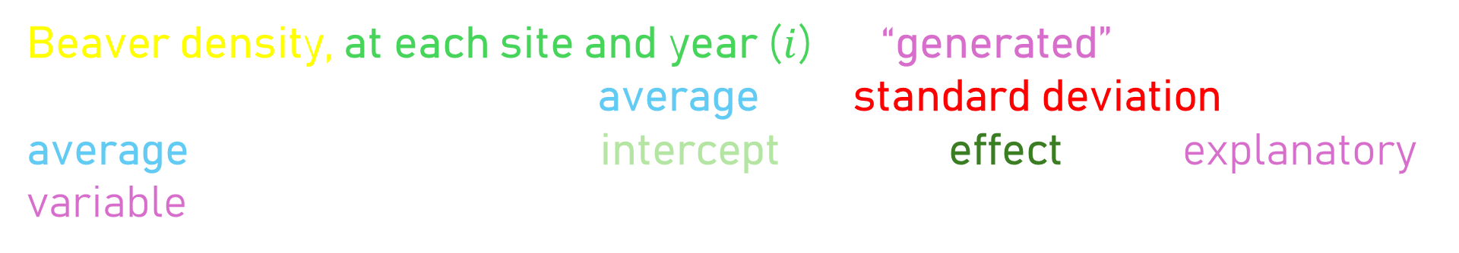
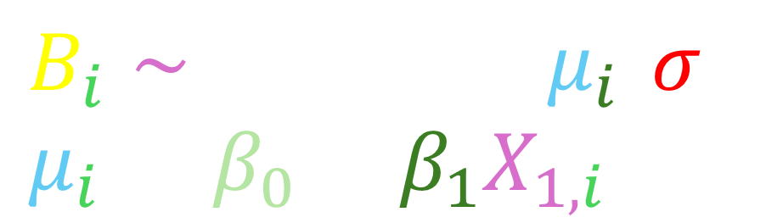
$$B_{i}∼Normal\left(μ_{i}, σ\right) \\ μ_{i}=β_{0}+β_{1}X_{1,i}$$
Beaver density, at each site and year ($i$), is “generated” according to a $Normal$ distribution, with an average and standard deviation. The average is determined by an intercept and the effect of an explanatory variable (called $X_{1}$ here)

Slide 13



$$B_{i}∼Normal\left(μ_{i}, σ\right) \\ μ_{i}=β_{0}+β_{1}X_{1,i}$$
$$+ β_{2}X_{2,i}$$
Beaver density, at each site and year ($i$), is “generated” according to a $Normal$ distribution, with an average and standard deviation. The average is determined by an intercept and the effect of an explanatory variable (called $X_{1}$ here)
To add more explanatory variables, we simply add them in

Slide 14

Including additional explanatory variables
Park protection
$$B_{i}∼Normal\left(μ_{i}, σ\right) \\ μ_{i}=β_{0}+β_{1}W_{1,i}$$
$$+β_{2}S_{i}$$
$$+ β_{3}P_{i}$$
$$+β_{4}R_{i}$$
Wolf presence
Beaver density
Beaver survival
Beaver reproduction

Slide 15
Human impact
Persecution
Hunting
Wolf presence
Elk density
Aspen density
Beaver density
Survival
Reproduction

Slide 16
Park status
Human impact
Persecution
Hunting
Wolf presence
Elk density
Aspen density
Beaver density
Survival
Reproduction

